Slide 1
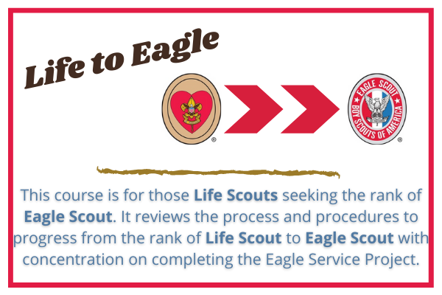
Notes:
Presenter Notes: This is information intended as guidance for the presenter only!
Presentation Summary: This presentation addresses the process and requirements for completing the Eagle Scout rank.
Time Required: 45-60 minutes including introductions; up to an hour and a half with questions and answers.
Target Audience: Unit leaders, advancement administrators, Scouts and parents.
Learning Objectives: To understand the value of the Eagle Scout rank and the procedures for Scouts and leaders to follow in completing a successful project.
Materials to review prior to presenting this session:
Guide to Advancement, No. 33088, current version
Eagle Scout Service Project Workbook, No. 512-927, current version
Eagle Scout Rank Application, No. 512-728, current version (note Requirement 5)
State: “Scouts render a tremendous service to their communities through the Eagle Scout rank while learning to plan and manage project efforts that they will most likely find themselves involved with later in life.”
“During this presentation we will the requirements, cover the nature of the project, the administrative processes and an overview of the Eagle Scout Service Project Workbook.”

Slide 2
Agenda
Eagle Scout Rank Requirements
Eagle Scout Application
Eagle Scout Board of Review
Eagle Scout Service Project Summary
Eagle Scout Project Workbook

Slide 3
Advancement Committee
Advancement Chairs: Mark Oetinger & Kevin Volk
Professional Staff: Jess Bonham
District Advancement Chairs:
Great Trails: Dan Cochrane cochranedan@aol.com
Great Trails: Eric Volk e_e_volk@yahoo.com
North Star: John Maier john.g.maier@gmail.com
North Star: Mark Oetinger markoetinger1@gmail.com
Voyageur: Sean McIntyre smcintyre436@gmail.com
White Tail: Dave Talarico talaricodave@aol.com

Slide 4
Eagle Scout Rank Requirements
Be active in your troop for at least six months as a Life Scout.
What counts as ‘active’?
You need to be registered with the unit
You need to be in good standing
This is a disciplinary thing. You’ll know if it applies.
You need to meet the unit’s reasonable expectations
These expectations must be known in advance
Summers off still count; Scouting is year-round
If you don’t meet the expectation, there are alternatives

Slide 5
Eagle Scout Rank Requirements
As a Life Scout, demonstrate Scout Spirit by living the Scout Oath and Scout Law.
Tell:
How you have done your duty to God,
How you have lived the Scout Oath and Scout Law in your everyday life, and
How your understanding of the Scout Oath and Scout Law will guide your life in the future.
Notes:
List on your Eagle Scout Rank Application the names of individuals who know you personally and would be willing to provide a recommendation on your behalf, including parents/guardians, religious (if not affiliated with an organized religion, then the parent or guardian provides this reference), educational, employer (if employed), and two other references.

Slide 6
Eagle Scout Rank Requirements
Earn a total of 21 merit badges (11 more than required for the Life rank), including these 14 merit badges:
Camping
Citizenship in the Community
Citizenship in the Nation
Citizenship in the World
Citizenship in Society
Communication
Cooking
Emergency Preparedness OR Lifesaving
Environmental Science OR Sustainability
Family Life
First Aid
Personal Fitness
Personal Management
Swimming OR Hiking OR Cycling
Citizenship in Society is required as of July 1st, 2022
You may choose one of each badge in red, green, and blue for your 14 required badges.
You may use the others in place of non-required badges to fill up the list of 21, if you’ve earned them
Notes:
Citizenship in the Society required as of July 1st, 2022

Slide 7
Eagle Scout Rank Requirements
While a Life Scout, serve actively in your troop for six months in one or more of the following positions of responsibility:
Patrol leader
Assistant Senior Patrol Leader
Senior Patrol Leader
Troop Guide
OA Troop Representative
Den Chief
Scribe
Librarian
Historian
Quartermaster
Junior Assistant Scoutmaster
Chaplain Aide
Instructor
Webmaster
Outdoor Ethics Guide
Note: Assistant Patrol Leader is not on this list!
Notes:
Note: Venturing, Sea Scouts and Lone Scouts positions also qualify. See Scout Handbook for a list of those positions

Slide 8
Eagle Scout Rank Requirements
(Continued)
What counts as active service?
Something related to the desired results must happen
This is best achieved when the unit lays out clear and reasonable expectations for the position
If none exist, then the Scout or leader must work out the responsibilities
In any case, the Scouts may not be held to expectations that they haven’t been told
Notes:
Note: Venturing, Sea Scouts and Lone Scouts positions also qualify. See Scout Handbook for a list of those positions

Slide 9
Eagle Scout Rank Requirements
While a Life Scout, plan, develop, and give leadership to others in a service project helpful to:
any religious institution,
any school, or
your community.
The project must benefit an organization other than the Boy Scouts of America.
Your troop’s chartering organization is a valid beneficiary: the restriction is against the council and its properties (such as its camps and offices).

Slide 10
Eagle Scout Rank Requirements
(Continued)
Before you start, the project proposal must be approved by:
the organization benefiting from the effort,
your Scoutmaster,
your troop committee, and
the council or district.
You must use the Eagle Scout Service Project Workbook, BSA publication No. 512-927, in meeting this requirement.
Notes:
(To learn more about the Eagle Scout service project, see the Guide to Advancement, topics 9.0.2.0 through 9.0.2.16.)

Slide 11
Eagle Scout Rank Requirements
While a Life Scout, participate in a Scoutmaster conference.
Though many Scoutmasters like to use this as a sort of final capstone, there is no requirement that this be the last thing done before the Board of Review.
It is also possible to have several conferences, especially if you had several years between earning Life and Eagle. You may choose any of them for this requirement.
In any case, you must complete this and all previous requirements before your 18th birthday.

Slide 12
Eagle Scout Rank Requirements
Successfully complete your board of review for the Eagle Scout rank.
This may be done up to 24 months after age 18.
The board will be composed as follows:
There shall be no fewer than three and no more than six members, all at least 21 years old. They need not be on an advancement committee or registered with the BSA, but must not include or be selected by the Scout’s unit leaders or relatives.
There must be at least one district representative—who is not affiliated with the unit—present. The unit may request more than one.
Note: 24 months is a new, post-COVID change; the limit was formerly 3 months.

Slide 13
The 12 Steps from Life to Eagle
Complete all requirements
Select and gain approval for your Eagle Project Workbook with needed signatures
Complete Eagle Project and complete the Project Workbook with needed signatures
Complete the Eagle Rank application
Get the needed signatures on the application
Contact the References on your application

Slide 14
The 12 Steps from Life to Eagle
Submit and forward the application to the Council Advancement Professional along with a copy of your Eagle Project Workbook
Schedule a date for the Eagle Board of Review once your Letters of Reference are received
Complete Eagle Board of Review
Submit signed Application to Council
Council Executive signs Application and forwards to National
Eagle Credentials arrive at the Local Council

Slide 15
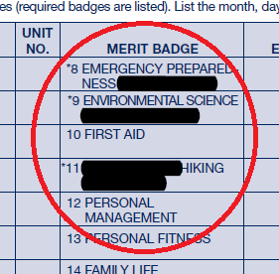
Completing the Application
Here are a few tips to make your application easy to process:
Be certain that you’re using the current version
The version date is on the lower right corner
Cross out merit badges not earned
This refers to the either/or choices from requirement 3: cross out the ones that you didn’t choose.
On electronic applications, you can do this with the highlighter tool set to black

Slide 16
Completing the Application
(Continued)
Include all references
You are required to provide information for all six references (five if you are not employed)
If you have no specific religious institution or association, then your parent provides this reference
The last two references are free for you to choose: there are no restrictions and anyone may serve as this reference, including a sibling or other relative, a friend at school, a Scout leader, a family friend, a neighbor, or even a boyfriend/girlfriend
You may provide contact information, ask your references to serve as references, and give them the form to complete, but that is as far as your involvement goes

Slide 17
Completing the Application
(Continued)
Fill out everything completely
Be sure that the time listed for your position of responsibility only includes time when you were a Life Scout; if you serve fixed terms for unit positions and the term began while you were a Star Scout, then your start date for this requirement is the date of your Life Scout Board of Review
Don’t forget to include the Eagle Project hours: this is the sum of total hours worked, which is your planning time plus worker time for every volunteer worker
Don’t forget to sign it!
Remember that the deadline is to complete the rank requirements by age 18; you may submit the application after

Slide 18
Eagle Scout Board of Review
Scout should be in full uniform
While the uniform is preferred, the requirement is to be neat in appearance and dressed appropriately according to the Scout’s means
All paperwork should be in order with proper signatures
The office verifies this before scheduling the Board of Review

Slide 19
Eagle Scout Board of Review
(Continued)
Paperwork includes :
Eagle Application
Eagle Project Workbook
Statement of ambitions and life purpose
This is exactly what it says it is: it’s not asking why you want to be an Eagle Scout or what Eagle means to you. It asks what you want to do with your life.
Reference Letters
The Board of Review cannot be stopped or delayed because of non-responsive references
The Scout will not be asked for replacements in that case

Slide 20
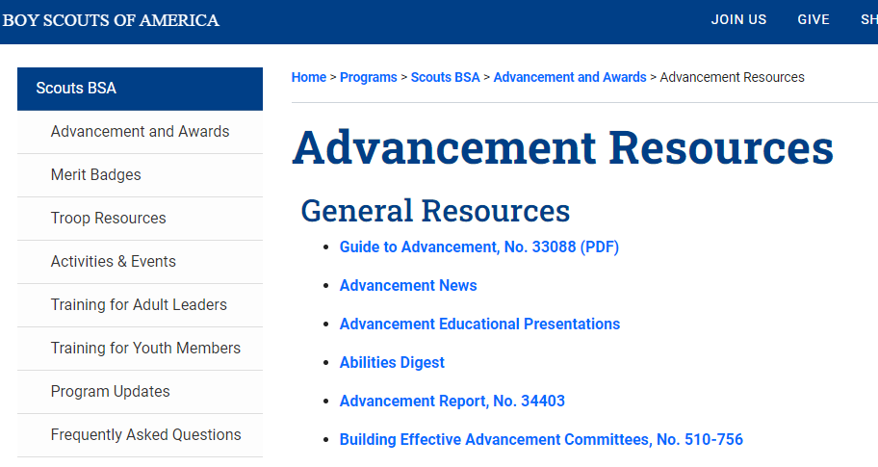
Eagle Scout Resources
https://www.scouting.org/programs/scouts-bsa/advancement-and-awards/resources/

Slide 21
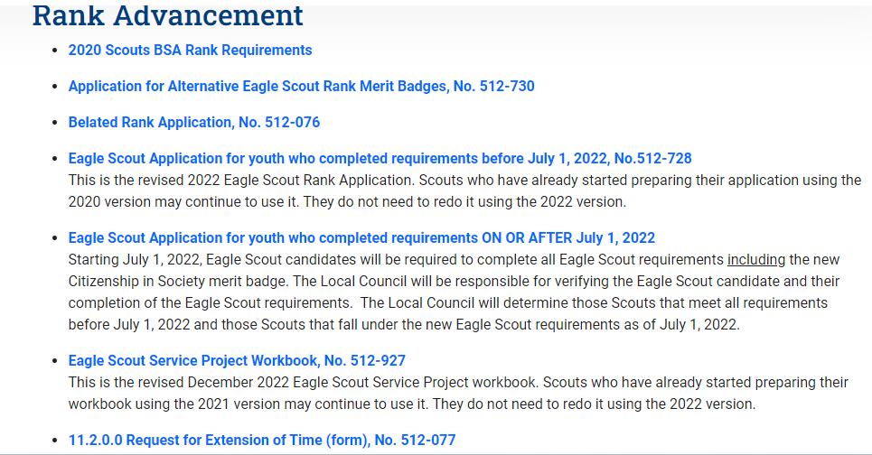

Slide 22
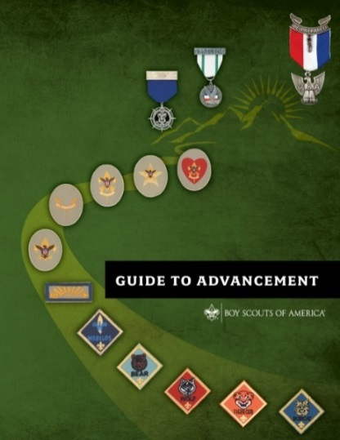
The Eagle Scout Service Project Guide to Advancement Section 9
National Advancement Program Team
Expiration Date
This presentation is not to be used after January 31, 2025.
Obtain an updated version at www.scouting.org/advancement
Notes:
Presenter Notes: This is information intended as guidance for the presenter only!
Presentation Summary: This presentation addresses the process and requirements for conducting Eagle Scout service projects.
Time Required: 45-60 minutes including introductions; up to an hour and a half with questions and answers.
Target Audience: Unit leaders, advancement administrators, Scouts and parents.
Learning Objectives: To understand the value of the Eagle Scout service project and the procedures for Scouts and leaders to follow in completing a successful project.
Materials to review prior to presenting this session:
Guide to Advancement, No. 33088, current version
Eagle Scout Service Project Workbook, No. 512-927, current version
Eagle Scout Rank Application, No. 512-728, current version (note Requirement 5)
State: “Scouts render a tremendous service to their communities through the Eagle Scout service project program, while learning to plan and manage project efforts that they will most likely find themselves involved with later in life.”
“During this presentation we will cover the nature of the project, the requirements, the administrative processes and an overview of the Eagle Scout Service Project Workbook.”

Slide 23
The Eagle Scout Service Project GTA 9.0.2.0
Proposing, conducting and reporting on projects should be a positive experience for the Scout.
The focus and energy for the project is meaningful service while practicing leadership skills.
Administrative issues are merely supportive of this meaningful service.
Only one Eagle Scout candidate receives credit.
Notes:
The Eagle Scout service project is meant to be a positive experience for a Scout.
The Scout’s focus and energy for the project is in meaningful service to others while practicing leadership skills.
We don’t want Scouts spending large amounts of time on the administrative parts of the process.
While the development of the proposal, plan and report are important parts of the process, we want a Scout’s focus and energy on the completion of the project and their demonstration of leadership and service to the community. We must always keep these objectives of the project in perspective.
Only one Eagle Scout candidate can receive credit for working on an Eagle Scout service project, because only one Scout can be the leader.

Slide 24
The Eagle Scout Service Project What an Eagle Scout Candidate Should Expect GTA 9.0.2.1
Questioning shall be conducted in a helpful, friendly, courteous and kind-hearted manner.
A parent or other observer may be present during reviews.
Project expectations are stated in Eagle Scout Requirement 5.
If requested, a written explanation must be given for any proposal rejection.
Notes:
While working toward completion of the project this is what a Scout should expect, especially during the proposal and approval process:
During the proposal approval stage of the project questioning will cover the project concept, the proposal and what must be done for the project to be successful. Questioning shall be conducted in a helpful, friendly, courteous and kind-hearted manner.
Project expectations are stated in Eagle Scout requirement 5. We do not require any more than what is stated in the Eagle Scout Service Project Workbook.
If it is requested by the Scout or their parents, a written explanation must be given for any proposal rejection. A copy is sent to the council advancement committee chair and staff advisor. It will indicate reasons for rejection and suggestions of what can be done to achieve proposal approval.

Slide 25
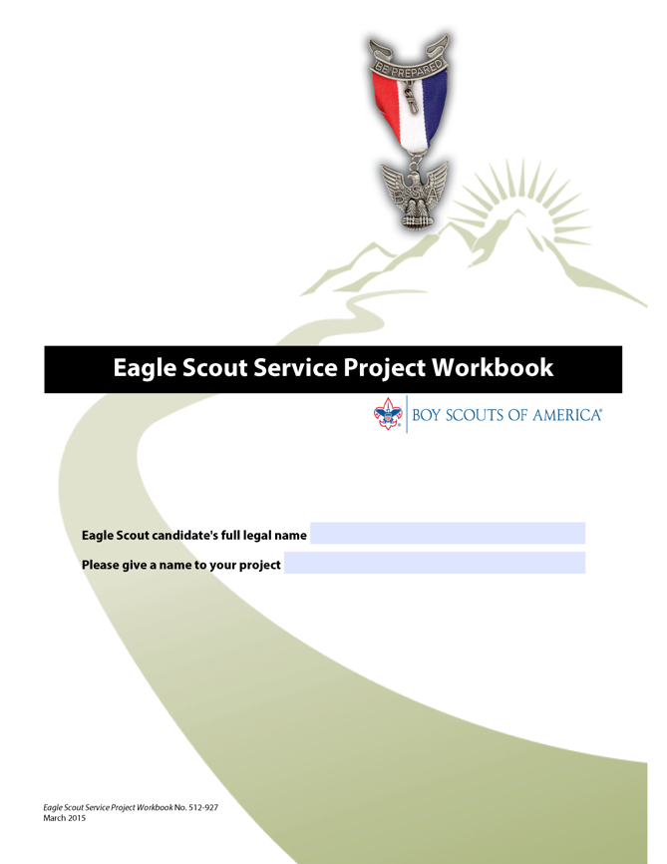
The Eagle Scout Service Project What an Eagle Scout Candidate Should Expect
Guidance should be readily available.
If a candidate believes they have been mistreated or the proposal was wrongfully rejected, they will be provided a method of redress.
Notes:
Guidance that maximizes the opportunity for completion of a worthwhile project will be readily available and strongly recommended. Ultimately, however, responsibility for success belongs to the Scout and final evaluation is left for the board of review.
If a candidate believes they have been mistreated or the proposal wrongfully rejected, they will be provided a method of redress. This will include a second opinion and approval either through another volunteer or professional advancement administrator, or a council executive as determined by the council advancement committee and executive board.
GTA Section 9.0.2.1.

Slide 26
Eagle Scout Service Project Eagle Scout Requirement 5 GTA 9.0.2.2 – 9.0.2.4
While a Life Scout, plan, develop and give leadership to others in a service project helpful to any religious institution, any school or your community. (The project must benefit an organization other than the Boy Scouts of America.)
A project proposal must be approved by the organization benefiting from the effort, the unit leader, the unit committee, and the council or district before a Scout starts.
A Scout must use the Eagle Scout Service Project Workbook, No. 512-927, in meeting this requirement.
Notes:
Let’s look at requirement 5.
While a Life Scout, plan, develop and give leadership to others in a service project helpful to any religious institution, any school or your community.
The project must benefit an organization other than the Boy Scouts of America.
A project proposal must be approved by the organization benefiting from the effort, the unit leader, the unit committee, and the council or district before a Scout starts work.
A Scout must use the Eagle Scout Service Project Workbook, publication number 512-927, in meeting this requirement. It’s wise to be sure the latest version has been downloaded and used.

Slide 27
Eagle Scout Service Project Eagle Scout Requirement 5
“While a Life Scout…” Work on the project, including planning, begins after the Life Scout Board of Review. (9.0.2.2)
“Plan, Develop…” Planning and development are detailed once a project proposal is approved. (9.0.2.3)
A proposal is different from a plan.
Notes:
Now let’s look at what each part of the requirement means.
“While a Life Scout… “ Work on the project, including the planning, begins only after the Life Scout board of review. However, this is not meant to prevent an enthusiastic Star Scout from talking to their unit leader, religious leader, or principal about what a good project might be.
Next, we have the words “Plan and Develop ….” Planning and development require forethought, effort, and time. Sometimes more time than what it will take to actually execute the project itself. Thus, for the most part, planning is considered as part of the project and detailed further once the proposal is approved.
It is very important to differentiate between a project proposal and a project plan. It is inappropriate to expect the Scout to invest the time required for detailed planning of their proposal only to face the possibility of the proposal being rejected.
As an example, a Scout who wants to build a foot bridge does not need to have a set of detailed engineering plans and materials at the time of their proposal. The Scout may want to have an estimated cost and other information proving the feasibility of the project, but does not need a fully formed plan at this stage.

Slide 28
Eagle Scout Service Project Eagle Scout Requirement 5
“Give Leadership to Others…” “Others” means at least two people besides the Scout. (9.0.2.4)
Each project must be evaluated case by case on its impact to the benefiting organization and on lessons that will advance the candidate’s growth. (9.0.2.4)
Councils, districts and units shall not establish requirements for the number of people led, or their makeup, or for the time worked on a project. (9.0.2.4)
Notes:
The next phrase is “Give Leadership to Others…”. “Others” means at least two people besides the Scout. Helpers may be involved in Scouting or not and of any age appropriate for the work. In cases where just three people are not able to conduct the project to the satisfaction of the project beneficiary, more would be advisable. It may be, however, that a well-chosen project conducted by three provides an impact not achievable with those involving more people.
One of the purposes of the project is to demonstrate leadership, but perhaps this could be considered a more important element for a Scout who has not yet established themselves as a leader.
It is for reasons like these that every project must be evaluated, case-by-case, on its positive impact to the benefiting organization, and on lessons that will advance the candidate’s growth.
Councils, districts and units shall not establish requirements for the number of people led, or their makeup, or for the time worked on a project. Nor shall they expect Scouts from different backgrounds, with different experiences and different needs, all to work toward a particular standard. Keep in mind that service projects are a unit activity and are subject to Boy Scouts of America policies and procedures (Guide to Advancement topic 9.0.2.14)
The Eagle Scout service project is an individualized experience. The Eagle is earned by individual Scouts, and each one is different. Everyone earns their own Eagle.

Slide 29
Eagle Scout Service Project Eagle Scout Requirement 5
“Helpful to any religious institution, any school, or your community.” (9.0.2.5)
“Your community” can mean the world community. A council may emphasize more local efforts but should not deny worthy projects of a wider scope.
Scenarios where an individual in need can affect a community may be considered.
“Benefit an organization other than the Boy Scouts of America”. (9.0.2.6)
Notes:
The next phrase is “…. Helpful to any religious institution, any school, or your community.” Any religious institution or any school is reasonably self-explanatory. But what does “your community” mean?
If a Scout wants to take their oath to help other people to another level and put their project to work for the community of the world, they are allowed to do so. A council may emphasize more local efforts but should not deny worthy projects of a wider scope.
Normally “your community” would not refer to individuals, although a council or district advancement committee may consider scenarios where an individual in need can affect a community. For example, the situation of elderly persons living at home but unable to maintain their property, with the result being an attractive nuisance or related dangerous situations, or even an eyesore, is something that raises concern for more than just an individual. If it can be determined the community benefits, then it is a matter of identifying who will provide beneficiary approvals.
Those approvals must come from a source representing the community such as a neighborhood association watch group, homeowner’s association, or perhaps a division of a town or county.
The project beneficiary need not be a registered non-profit organization. Projects may not be of a commercial nature or for a business, but this is not meant to disallow community institutions that would otherwise be acceptable to the council or district advancement committee. Those could be museums or various service agencies, or some homes for the elderly. Some aspect of a business’s operation provided as a community service may also be considered.
For example, a park open to the public that happens to be owned by a business could be considered. In cases such as these, the test is whether the project primarily benefits the community, as opposed to the profits of the business.
The next statement is: “Benefit an organization other than the Boy Scouts of America”. Projects must not be performed for the Boy Scouts of America or its councils, districts, units, camps, and so forth.
The unit’s chartered organization, however, is certainly a good candidate, as are other youth organizations such as the Girl Scouts of America, Boys and Girls Clubs of America, or other international Scouting organizations.

Slide 30
Eagle Scout Service Project Eagle Scout Requirement 5
“Proposal must be approved…before you start” (9.0.2.7)
Five Tests of an Acceptable Eagle Scout Service Project:
1. Sufficient opportunity to meet the requirement.
2. Appears to be feasible.
3. Safety issues will be addressed.
4. Action steps for further detailed planning are included.
5. The Scout has a reasonable chance for a positive experience.
Notes:
The requirement continues with: “A project proposal must be approved…before you start”. The proposal is an overview but it is also the beginnings of planning. It shows a unit leader or any representatives of a unit committee or district or council that the following five tests can be met and be applied to each project individually:
The project provides sufficient opportunity to meet the requirement.
2. The project appears to be feasible.
Safety issues will be addressed. We want to see assurance that safety issues will be fully considered during planning, but they do not need to be fully addressed at the proposal stage of the project.
Remember, since and Eagle Scout service project is a unit activity, unit adult leadership has the same responsibility to assure safety in conducting a project as with any other unit activity (Guide to
Advancement topic 9.0.2.14).
4. Action steps for further detailed planning are included. These are the steps necessary for the planning phase of the project, not for actually completing the project.
5. The Scout has a reasonable chance for a positive experience.

Slide 31
Eagle Scout Project Workbook GTA 9.0.2.8
The workbook cannot be modified.
If properly used, the workbook very nearly assures success.
Should not be used as a source for rejecting candidates based on “technicalities”.
Write-ups and signatures are simply supportive.
Keeps the Scout on the right track with a reasonable chance for success and a positive experience.
The official document as produced by the Boy Scouts of America must be used. www.scouting.org/advancement.
Notes:
There is one and only one Eagle Scout Service Project Workbook. It cannot be modified and if properly used, it very nearly assures success.
It should not be used as a source for rejecting candidates based on “technicalities”. While the use of the workbook is required, this does not mean that every line or even every form must be completed. Refer to the Guide to Advancement topic 9.0.2.8.
Remember that write-ups and signatures are simply supportive to the project activity. It is the actual project that we are interested in.
If properly used, the Eagle Scout Project Workbook keeps the Scout on the right track with a reasonable chance for success and a positive experience.
The official Eagle Scout Service Project Workbook, as produced by the Boy Scouts of America, must be used. It is available from www.scouting.org/advancement.

Slide 32
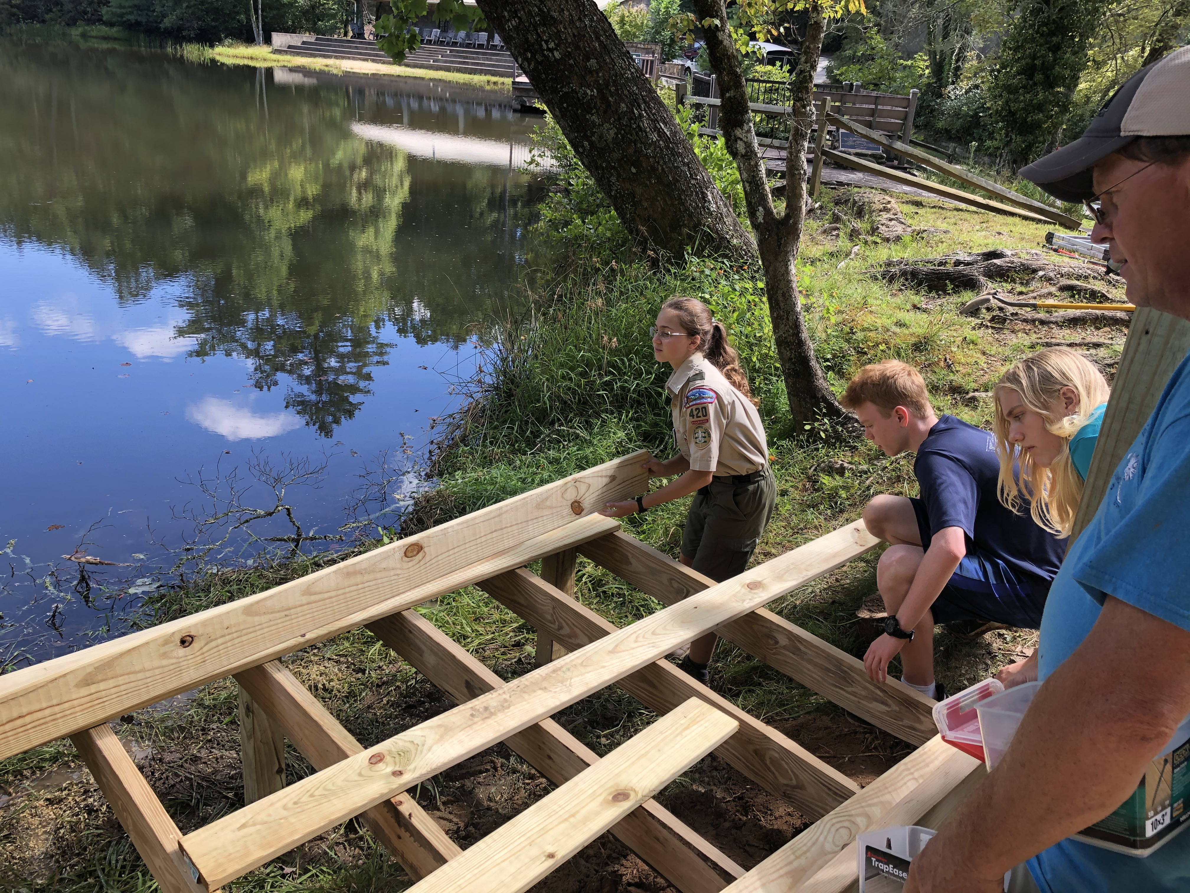
Eagle Scout Service Project Coach GTA 9.0.2.9
Coaches must be registered with the BSA, in any position and be current in BSA Youth Protection training.
A project coach is not required but highly recommended.
Using a project coach is the Scout’s decision.
Coaches work in an advisory capacity.
Coaches do not have the authority to dictate changes or withdraw approval.
Notes:
The Eagle Scout service project coach is the subject matter expert on the process and standards of the service project.
The coach is not a new or separate position in Scouting. Coaches come from other positions in Scouting such as a unit, district, or council committee. It is up to the council to determine who can serve as project coaches and how they may be assigned.
Coaches must be registered with the BSA (in any position) and must be current in Youth Protection training.
A project coach is not required but highly recommended. It is a Scout’s decision whether to use a coach or not.
Their greatest value is in the advice they provide after the project proposal has been approved. The coach’s benefit to the Scout is their knowledge and experience with project approvals.
Coaches work in an advisory capacity. They use the method of positive adult association to help the Scout.
Coaches can help a Scout see that if a plan is not sufficiently developed, a project could fail. Coaches meet with the Scout to review their plan, discuss its strengths, weaknesses, risks, and suggest critical improvements, if necessary.
Coaches do not have the authority to dictate changes to the plan, withdraw proposal approval, or take any other directive action.
The final decisions regarding the project plan are those of the Scout and the beneficiary only.

Slide 33
Eagle Scout Service Project Fundraising GTA 9.0.2.10
Projects themselves may not be fundraisers.
Fundraising is permitted only for securing materials and otherwise facilitating the project.
Fundraising must be approved by the council unless funds are derived only from contributions by the beneficiary, the candidate, their relatives, the unit, its chartered organization, or from parents or members of the unit.
Procedures and limitations for Eagle Scout service project fundraising can be found on the back of the fundraising application, inside the workbook.
Notes:
Eagle Scout service projects themselves may not be fundraisers.
Fundraising is permitted only for securing materials and otherwise facilitating completion of the project.
Fundraising must be approved by the council for fundraising and in-kind donations. The only exceptions to this rule are funds derived from contributions by the beneficiary, the candidate, their relatives, the unit, or its chartered organization or from parents or members of the unit. The completed Eagle Scout Service Project Fundraising Application must be sent to the local council for review. Consult the Eagle Scout Service Project Workbook and the Guide to Advancement for more information on fundraising.
Procedures and limitations for Eagle Scout service project fundraising can be found
on the back of the fundraising application, inside the service project workbook.

Slide 34
Evaluating the Project After Completion GTA 9.0.2.13
Completed projects must be evaluated on impact – the extent of benefit to the benefiting organization and on the leadership provided.
There must be evidence of planning and development.
There may be cases where the unit leader or beneficiary choose not to approve the project.
Sometimes a project is not completed as planned.
Notes:
Completed projects must be evaluated on impact – the extent of benefit to the benefiting organization and on the leadership provided by the candidate.
There must be evidence that the candidate planned and developed the project as necessary to execute the project. Reviewers must not require more planning and development than was necessary to execute the project.
There may be cases where the unit leader or beneficiary choose not to approve the project. One or the other may have decided that project modifications were so significant that the extent of service or the impact of the project were insufficient to warrant approval. In these cases, a candidate may be asked to do more work or even start over with another project. It is the candidate’s choice to do more work, start over, proceed to request a board of review, or by submitting the project workbook without final approval. It will be up to the board of review members to determine if what was accomplished met the intent of the requirement.
Sometimes a project is not completed or not completed as planned. Again, it is up to the board of review members to determine if there was sufficient planning, development, and leadership, and the project provided sufficient impact to meet the intent of the requirement.

Slide 35
Risk Management and the Project GTA 9.0.2.14
All Eagle Scout service projects constitute official Scouting activity and are considered part of a unit’s program.
The health and safety of those working on Eagle projects must be incorporated into project execution. This is an adult responsibility.
The SAFE Project Tool Use and the Guide to Safe Scouting should be consulted during project planning.
Notes:
All Eagle Scout service projects constitute official Scouting activity and are part of a unit’s program. As such, Eagle Scout service projects are subject to the Boy Scouts of America policies and procedures including youth protection, two-deep leadership, insurance, etc.
The health and safety of those working on Eagle projects must be incorporated into project execution. Unit adult leaders have the same responsibility to assure safety in conducting a project as with any other unit activity. While a candidate should be guided to plan for safe execution, it must be understood that minors cannot and must not be held responsible for safety concerns.
The Sweet 16 of BSA Safety and the Guide to Safe Scouting should be consulted during project planning and execution. They can be found online at https://www.scouting.org/health-and-safety/gss/sweet16/ and https://www.scouting.org/health-and-safety/gss/ respectively.

Slide 36
For More Information
Guide to Advancement
www.Scouting.org/advancement
Eagle Scout Rank Application
Eagle Scout Service Project Workbook.
If you have questions, district and council advancement administrators first, then: Advancement.team@scouting.org
Notes:
For more information check the Guide to Advancement Section 9; the Eagle Scout Rank Application and the Eagle Scout Service Project Workbook.
These can be found at www.scouting.org/advancement
Direct any questions you may have to your district or council advancement administrators first. If necessary, you can also contact the National Advancement Program Team at advancement.team@scouting.org.

Slide 37
Questions?

