Slide 1

Welcome to
Pack 380
Popcorn Kickoff
It’s going to be an AWESOME year
Notes:
Customize for your unit: Change “Pack 123” to your unit information.

Slide 2
It’s going to be an AWESOME year
This year, our Unit is
planning to do the following
activities and events:
Halloween Fun Day – October
Holiday Party - December
Blue & Gold Banquet – February
Maple Fun Day- March
Pinewood Derby – March - April
Scout Family Camping - June
Cub Scout Resident Camp – July - August
Notes:
Customize for your unit: Add the activities your unit plans to do this year.

Slide 3
How are we going to do all this fun stuff?
It’s going to be an AWESOME year

Slide 4

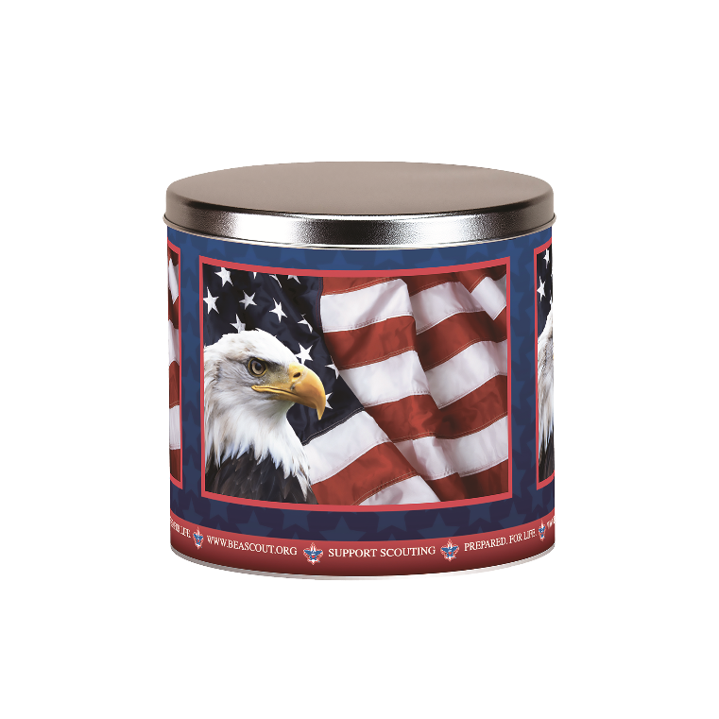

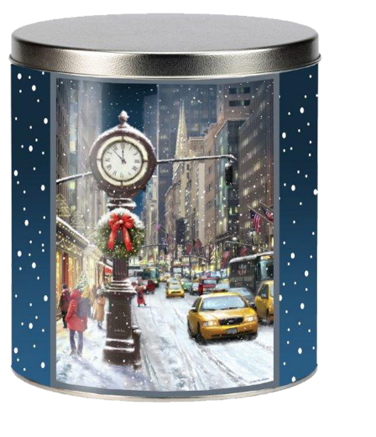
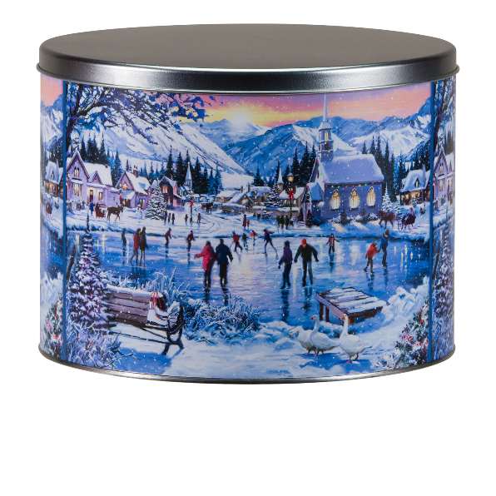
Sell
Popcorn!!!!

Slide 5

Why Popcorn?

Slide 6
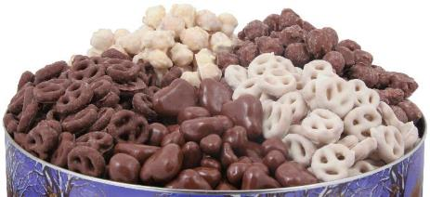

Why
CAMP MASTERS Popcorn?
It’s EASY TO SELL & people LOVE to Support Scouts

Slide 7

PRIZES!

Slide 8

High Achievers Prizes
$750 Club
Choice of an Outdoor Adventure Set or a Zing Air Zoom Zooka
Weekly Drawings
Drawings every Friday 9/4 to 10/23 for Scouts who Fill-A-Sheet for a great prize
$1,000 Club
Entry into a drawing for one of three great prizes (I-Pad or Kindle or a Nintendo handheld game) for EVERY Scout that sells $1,000 worth of Popcorn
Top Seller in Each District: TBA at the August 4th Kickoff
Top Selling Unit in the Council: TBA at the August 4th Kickoff
Notes:
Customize for your unit: Does your Council offer special Popcorn Sale Incentives? If so, be sure to include them here.

Slide 9
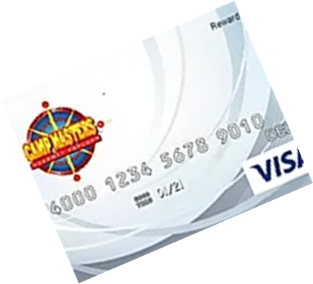
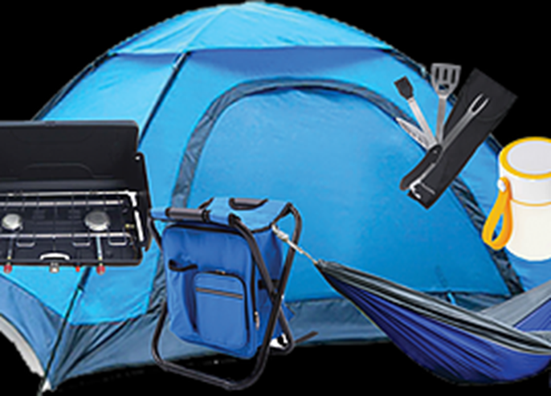
High Achievers Prizes
Sell $3,000 or more and earn a Camping Package or Visa Debit Card for 5% of your Total Sale
Qualifiers of the previous scholarship program will be grandfather into High Achievers program
Example: $3,000 would equal $150 Debit Card. Debit cards are rounded to the nearest $10

Slide 10

Unit Prizes
Pack 375 Incentives
Top Selling Scout Prize = BMX Bike
Top Selling Den Prize = Pizza Party
Sell $1,000 and throw a pie in your Leader’s face!
Notes:
Customize for your unit: Add your Pack/Troop’s incentives, like a reward for the Top Selling Scout or a bonus prize for the Top Selling Den.

Slide 11
What We’re Selling!

Slide 12

Limited Edition Buffalo Bills Tin!
First Ever Collectible Tin!
Limited Edition & Quantities!

Slide 13
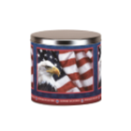







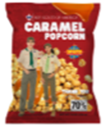


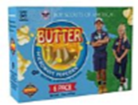


Show ‘N’ Sell Product! (14)
3 Way Cheesy Cheese Tin
Supreme Caramel Crunch with Almonds, Pecans and Cashews
22 Pack Movie Theatre
Extra Butter Microwave Popcorn
Buffalo Bills Tin
Caramel Corn
Trail Mix
Cinnamon Crunch Popcorn Tin
Salted JUMBO Cashews
14 Pack Microwave EXTRA
Butter Roasted Summer Corn
Purple Popping Corn Jar
White Cheddar Cheese Tin
12 Pack Sweet & Salty Kettle Corn Microwave Popcorn
Honey Roasted Peanuts
Caramel Popcorn Bag
6 Pack Microwave Butter

Slide 14


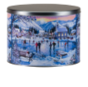

Take Order Product! (17)
Chocolatey
Treasures Tin
Premium Tin
Chocolatey Carmel, Sweet & Salty Kettle, & Butter Toffee
3 Way Cheesy Cheese Tin
Supreme Caramel Crunch with Almonds, Pecans and Cashews
22 Pack Movie Theatre
Extra Butter Microwave Popcorn
Purple Popping Corn Jar
White Cheddar Cheese Tin
12 Pack Sweet & Salty Kettle Corn Microwave Popcorn
Honey Roasted Peanuts
Caramel Popcorn Bag
Military Donation
Chocolate Drizzled Carmel Popcorn
Buffalo Bills Tin
Caramel Corn
Trail Mix
Cinnamon Crunch Popcorn Tin
Salted JUMBO Cashews
14 Pack
Microwave EXTRA
Butter Roasted Summer Corn

Slide 15
How to Sell
Show and Deliver
Show-and-Sell
Sell Online at www.popcornordering.com

Slide 16
How to Sell
Scout Demonstration
“Hi sir / ma’am, my name is ______,
and I’m a scout with Pack /Troop_____.
We’re selling popcorn to help raise money for our Pack / Troop.
You can help us by trying some of our delicious popcorn.
You’ll help us out, won’t you?
Notes:
Invite two Scouts to the front of the room to role play a consumer and selling Scout.

Slide 17
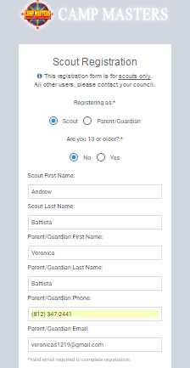
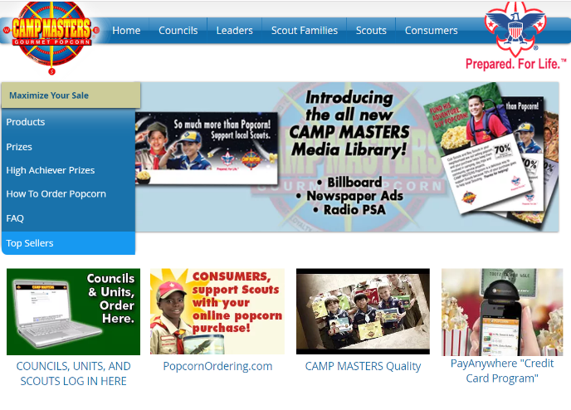
Self Register to Sell Online…
Scouts can Self-Register to sell online at www.campmasters.org
Click here
Notes:
Invite two Scouts to the front of the room to role play a consumer and selling Scout.

Slide 18


Sell Online…
30% Base Commission
+2% = When the average on-line sales of Scouts that participated is $1,000
Any Scout that sells $400 online will receive a $10 AMAZON Gift Card
Notes:
Customize for your unit: Use the Popcorn Planner to determine your unit’s sales goals and then the individual Scout goal.

Slide 19
Our Sale
Our Goals
Unit Sales Goal: $7,500
Scout Sales Goal: $650
Use the Fund Your Adventure Worksheet to determine your Unit’s plans for the year then determine how much Popcorn each Scout needs to sell to pay his own way!
Notes:
Customize for your unit: Use the Popcorn Planner to determine your unit’s sales goals and then the individual Scout goal.

Slide 20
Scouts, what’s your
GOAL?
Our Sale

Slide 21
Our Sale
Important Dates
Our sale starts August 21st and ends October 25th.
Show-and-Sell dates are September 10th at Walmart and September 24th at Dandy Mart
Orders are due by November 2nd .
Popcorn Pick Up is November 13th & 14th
Notes:
Customize for your unit: Enter your unit’s important dates here.

Slide 22
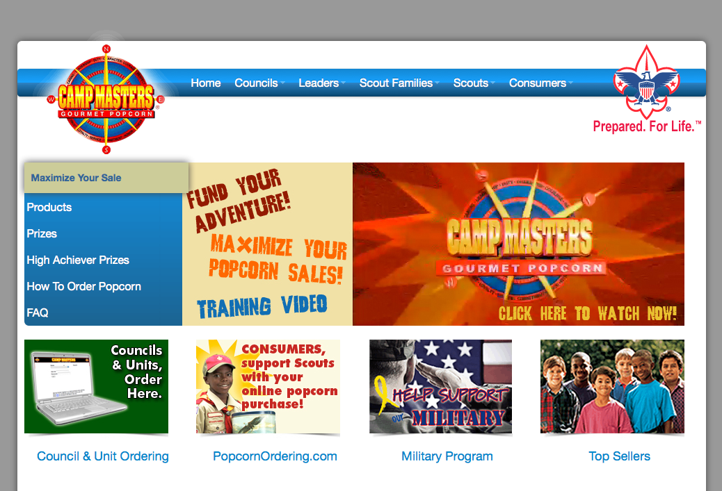
Our Sale
Do you want to learn more?
Contact our Popcorn Kernel
Name and Phone
Visit campmasters.org
for tips, tools and
product information.
Notes:
Customize with your unit’s Popcorn Kernel’s name and contact information.

Slide 23
Thank you!
Our Sale
Notes:
Customize for your unit: Change “Pack 123” to your unit information.

